Slide 1
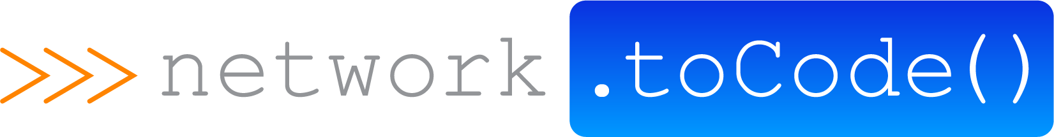
Arista ATD with Ansible Tower

Slide 2
Network to Code Services Offerings
Workflow Automation & Optimization
Software Development
Training / Workshops
Review Network Operations Workflows
Python for Network Engineers
DevOps Tools
Network Device APIs
Private/Public Courses
Custom network Applications
DevOps Tool Plug-Ins & Integrations
Helps Eliminate repetitive tasks
Optimize
Drive Down operational inefficiencies
Bootcamps
Ansible for Network Engineers

Slide 3
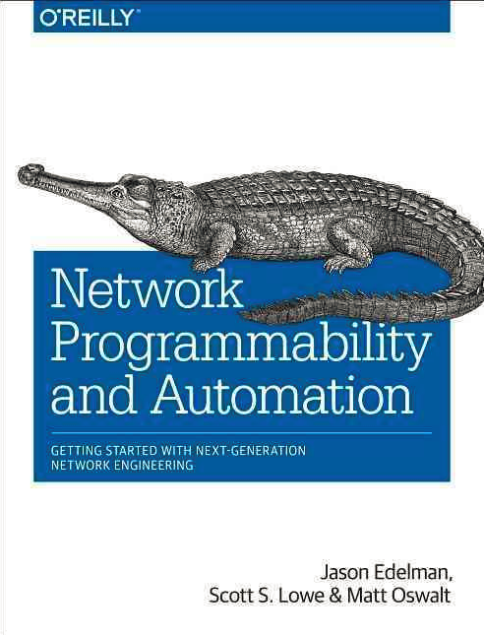
Win a FREE Network Automation Book!
Drop off a business card
Have the chance to win Network Programmability and Automation

Slide 4
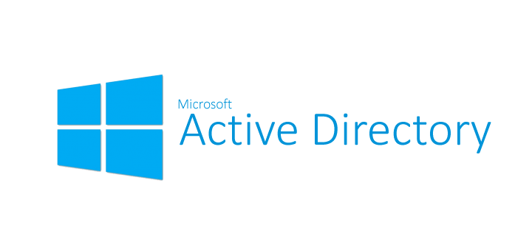
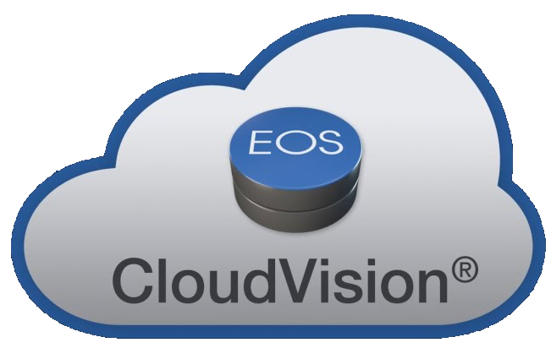

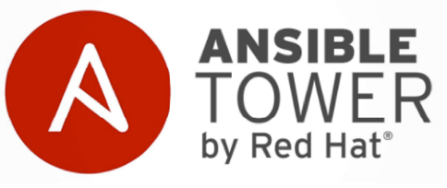



Arista ATD Integration Components

Slide 5


Leaf - Spine Topology
eBGP used both within the underlay and overlay
iBGP between MLAG peers
Hosts are dual connected
Host 1 in Vlan13
Host 2 in Vlan12
Host 3 in Vlan13
Host 4 in Vlan12
Looking for Layer2 reachability across VXLAN/EVPN fabric
AS
101.0
.1
eBGP
100.1.11.0/30
eBGP
100.2.11.0/30
AS
101.1
AS
101.2
.2
iBGP
VARP
MLAG
Host1
- Vlan 13
- 10.11.13.11/24
Host2
- Vlan 12
- 10.11.12.12/24
Host3
- Vlan 13
- 10.11.13.13/24
Host4
- Vlan 12
- 10.11.12.14/24

Slide 6
Scope of work
Start with a default configuration on our Arista switches
Validate that the Linux servers cannot reach their default gateway
One-Click build our entire underlay and overlay with Ansible
Build each device’s configuration section-by-section, assemble, and push
Validate that the Linux servers can reach their default gateway
Showcase a working EVPN fabric where host 2 can ping host 4
Layer 2 adjacency across a VXLAN tunnel
Add a new VLAN to the EVPN fabric with a targeted playbook
Validate that host 1 can now ping host 3

Slide 7
Use cases for Ansible Tower
Integrations with CVP, ServiceNow, Slack and NetBox
Validate network compliance of state and configuration
Obtain real-time facts from network devices or CVP
Configure multi-vendor environments
Copy / Install / Upgrade network OS across your network
Integrate dynamic inventory with CVP, Netbox, etc.
Add network devices to monitoring solutions
Real-time notification of configuration changes

Slide 8
github.com/networktocode/arista-atd

Slide 9
Network to Code At A Glance
WHAT WE DO
Network to Code provides high value services, training, and development in the network programmability and automation space.
WE BRIDGE THE GAP BETWEEN DEVOPS AND NETWORK ENGINEERING

